Slide 1
Intro to Statistics

Slide 2
Measures of Central Tendency

Slide 3
Measures of Central Tendency
The MODE of a data set is the most frequently occurring element.
For example, in a list like [1, 1, 2], 1 would be the mode.
The MEDIAN of a data set is the middle element
To find the median, we first sort the data, and select the middle element. In [1, 2, 3], 2 is the median.
For even-length data sets, we have two elements in the middle of the list.
We generally return the average of the two elements as the median of such a list.
Explain that the MEAN of a data set is what is commonly called the average of a data set.
To calculate the mean, we sum all of the numbers in the data set, and divide by the length of the data set.

Slide 4
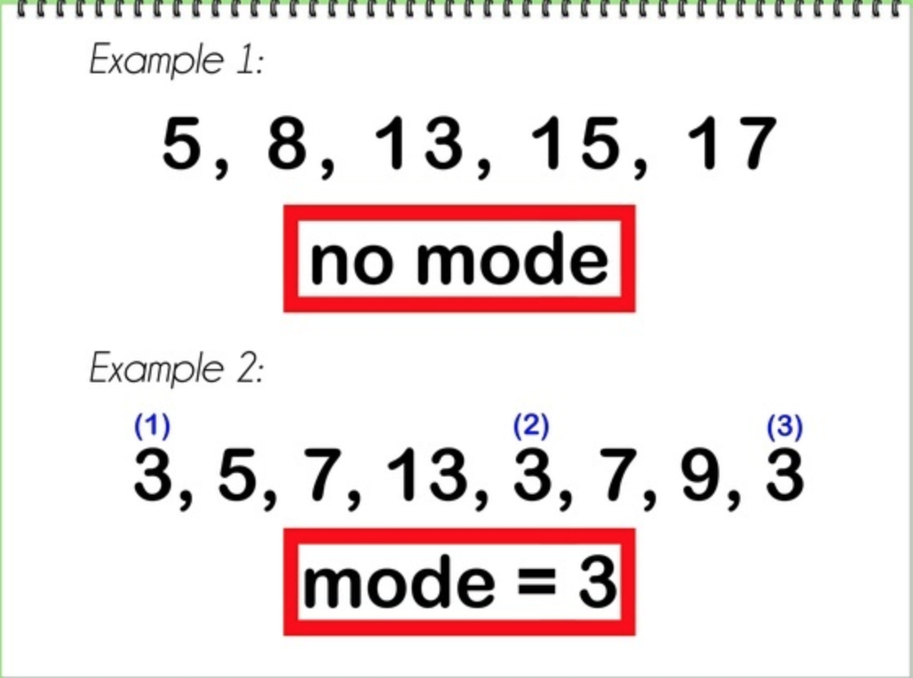
Examples - Mode

Slide 5
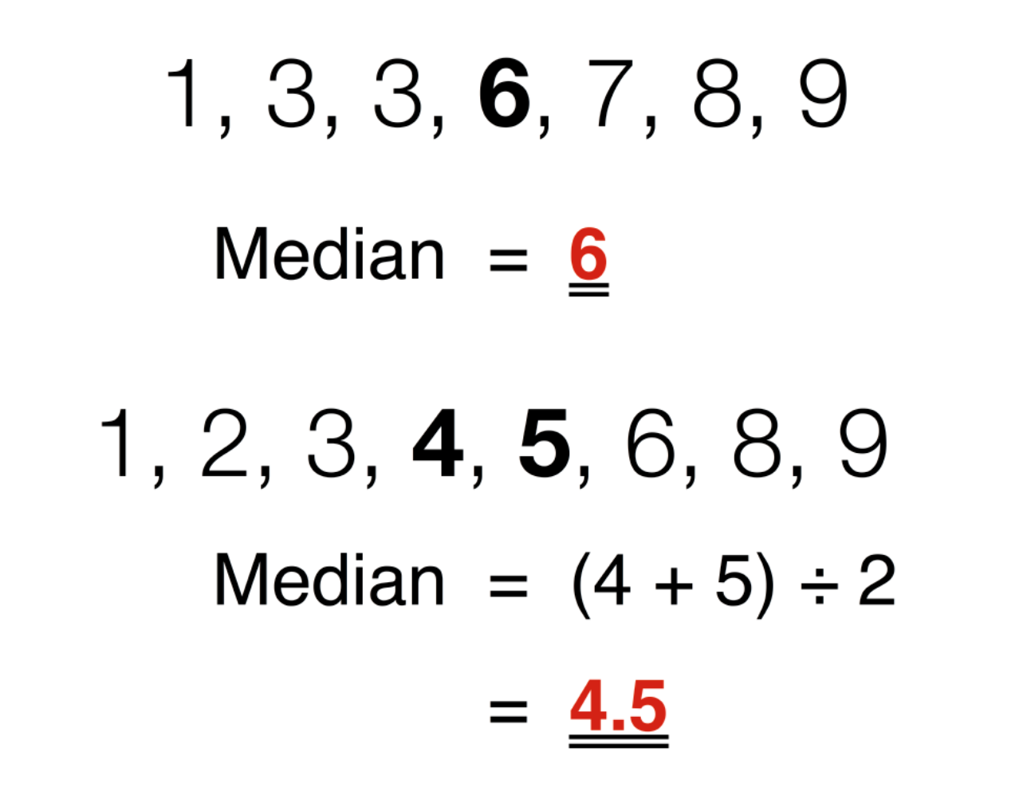
Examples - Median

Slide 6
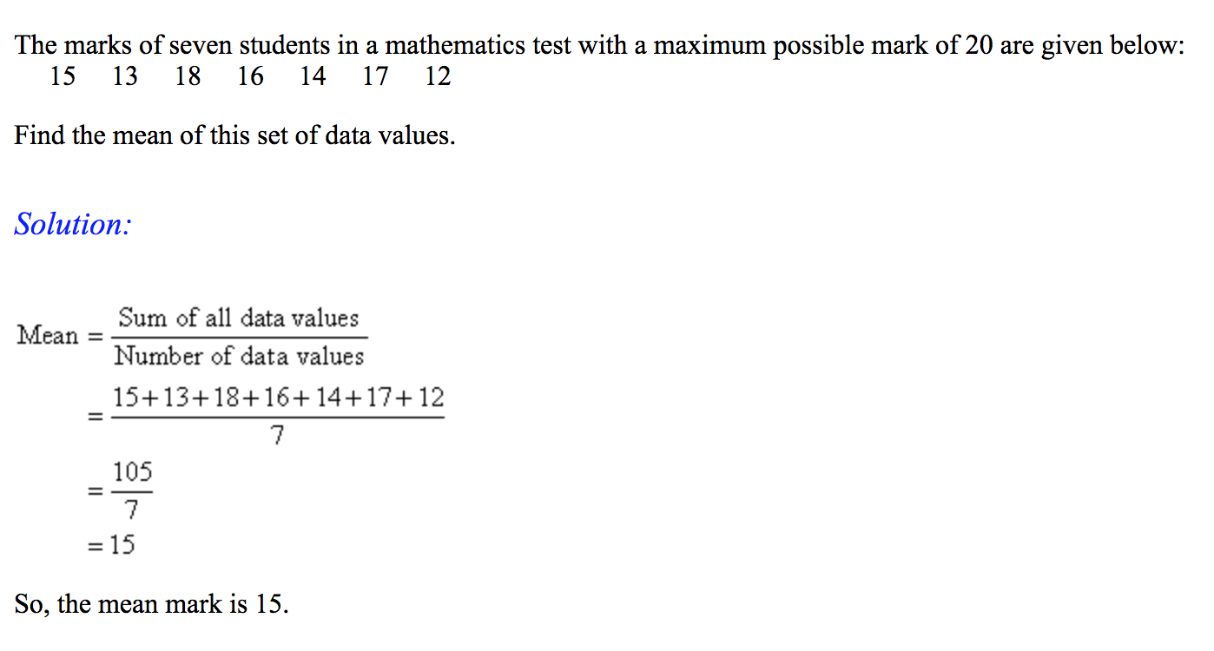
Examples - Mean

Slide 7
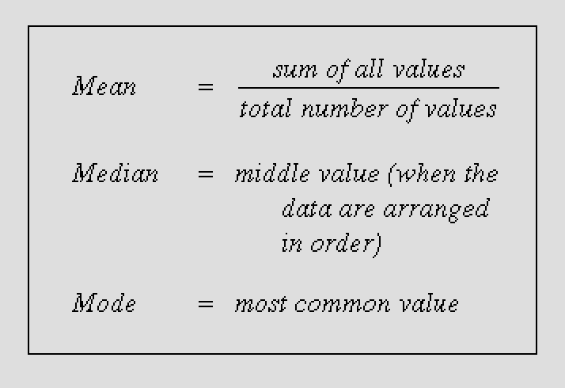
Measures of Central Tendency - The Why?
The purpose of each of these numbers is to allow us to describe an entire data set with a single number.
While each of these numbers allows us to describe a data set, they are not always equally descriptive….

Slide 8
A Case for the Median - Skewed Data
The median is a good choice for describing just about any data set.
Example:
These are prices from a local department store: [30, 31, 31, 32, 32, 40, 41, 41, 1000].
The median, 40, is a reasonable description of the "average" price in the data set.
The mean, which works out to 154.75, does not describe the data very well — in fact, the mean is a different order of magnitude than any of the prices in the data set!
This illustrates that the median tends to give relatively faithful descriptions even in the face of outliers, such as 1000.

Slide 9
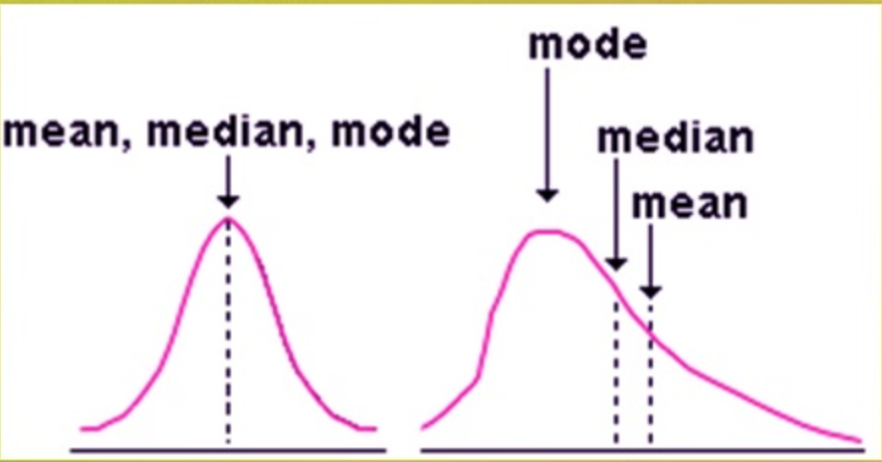
A Case for the Median - Skewed Data
Advantages:
In general, the median is more "resistant" to extreme fluctuations in data than the mean. (outliers)
This property often makes the median a better choice than the mean, in spite of the fact that the mean is more common. It’s almost always safe to use the median to describe data.

Slide 10
A Case for the Mode - Clusters
Sometimes, we might have data where values cluster in several places.
Consider this longer list of prices: [30, 31, 31, 32, 32, 40, 41, 41, 1000, 1210, 1210, 1567]
In this case, the mean, 438.75, still differs from the typical price in either the low or high clusters by an order of magnitude.
The median, 40.5, also doesn't adequately describe the data.
Most prices are close to 40.5, but a large number of them — 30% — are much higher.
Data like this, which has two or more clusters of data that are spread apart from one another, is often best described by the mode.
The modes are 31, 32, 41, and 1210, numbers which do represent the spread of the data quite nicely.
If this data set had included only one instance of 1210, this "trick" would not work.
If this is not the case, we can describe the data using the modes alongside the median.

Slide 11
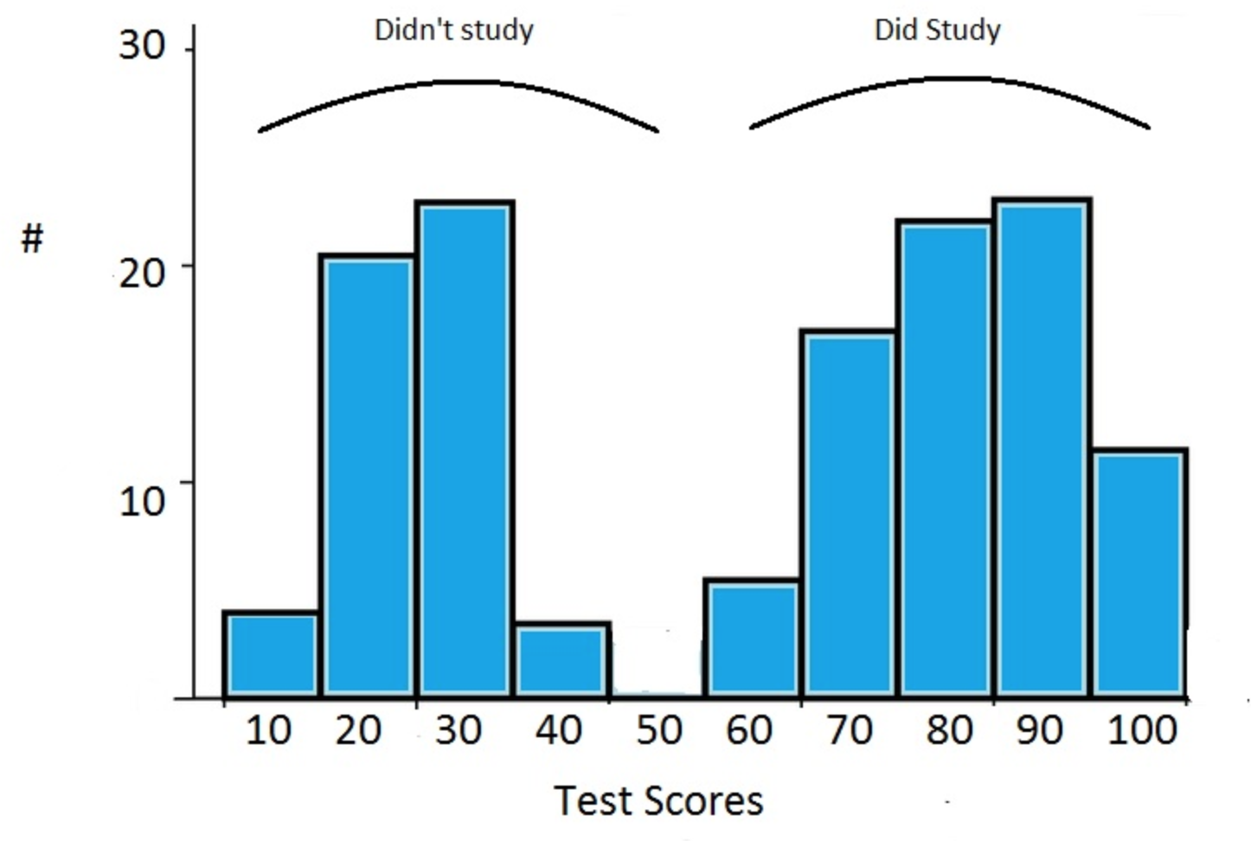
A Case for the Mode - Clusters
Data like this, which has two or more clusters of data that are spread apart from one another, is often best described by the mode.
This is because a data set can only have one median or mean, but multiple modes; and that the list of modes is likely to contain numbers from each cluster.

Slide 12
A Case for the Mean
The mean is most useful for describing data that are close together.
Example:
Consider the list of only low prices: [30, 31, 31, 32, 32, 40, 41, 41].
In this case, the mean, 34.75, is an accurate summary of the price data.
Real data sets are often more "spread out" than this, and that it is difficult to guarantee that a data set does not contain extreme values that skew the mean.
The median remains a good default statistic, even in these cases, as it will be fairly close to the mean — for this data set, the median is 32, which is just as "accurate" a summary as 34.75.
Advantage:
That one important potential advantage of the mean over the median is that it factors in every value of the data set, which the median and mode do not.

Slide 13
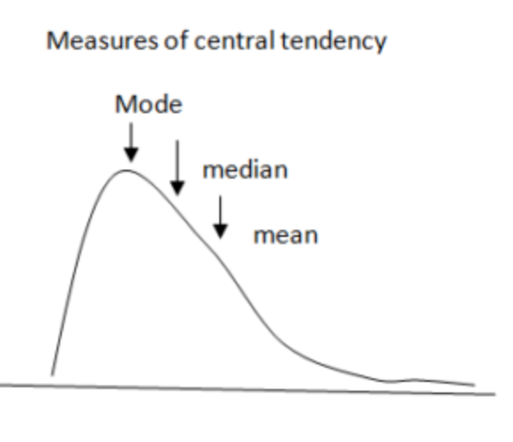
Central Tendency Example
samples.py

Slide 14
Variance, Standard Deviation and Z-score

Slide 15
How about the Spread of the Data?
Consider these two lists: [3, 4, 5, 6, 7] and [-1525, -200, 5, 745, 1000].
For both of these data sets, the mean and median are 5 — but they are obviously different!
In addition to knowing the the mean, median, and mode of a dataset, we clearly need to know something more about the data, namely, we need to know something about the spread of the data.
Important statistics that measure spread are:
Variance
Standard deviation
Z-score

Slide 16
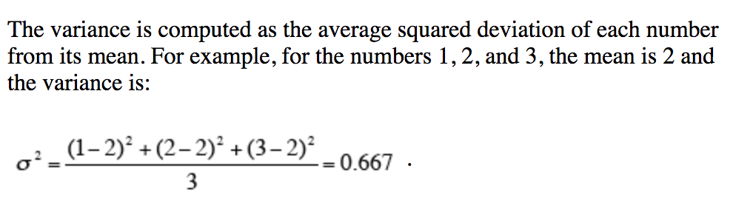
Variance
The variance of a data set is a single number that describes how "far apart" its values are.
Measured in units squared
http://davidmlane.com/hyperstat/A16252.html

Slide 17
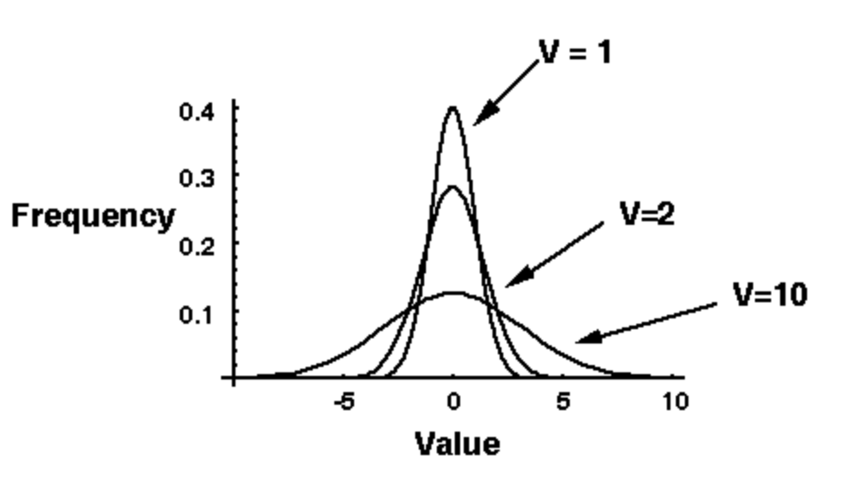
Variance
The more "spread out" a data set is, the higher its variance.
Example:
for the data set [3, 4, 5, 6, 7], the variance is 2.
for the data set [-1525, -200, 5, 745, 1000], the variance is 784,110.

Slide 18
Standard Deviation
The standard deviation is simply the square root of the variance.
For example, the variance of a data set containing the heights of average Australians would be in units of inches (or centimeters) squared.
It is not natural to talk about how much a data set measured in inches spreads in terms of square inches — it makes more sense to talk about how much data measured in inches spreads in terms of inches.
One of the motivators for using the standard deviation instead of the variance: It is easier to interpret.
The standard deviation for the data set [3, 4, 5, 6, 7] is approximately 1.414.
The standard deviation for the data set [-1525, -200, 5, 745, 1000] is approximately 885.5.

Slide 19
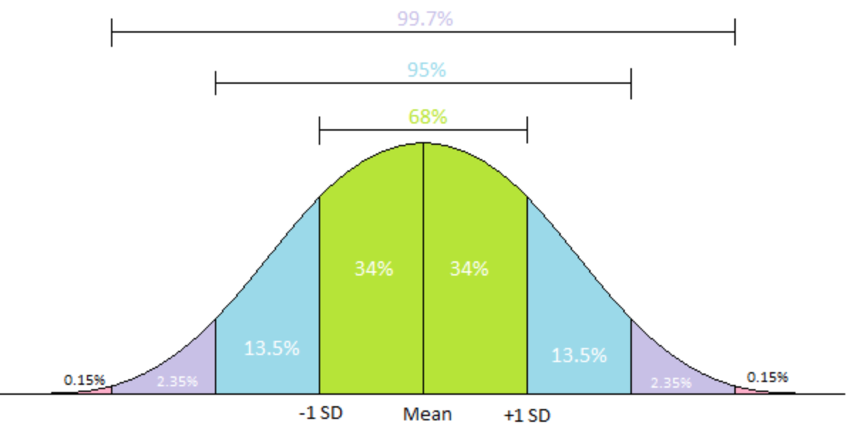
Standard Deviation
The way we often use the standard deviation as a unit to describe how far individual numbers in a data set are away from the mean.
Intuitively, the standard deviation tells us how far away from average any number in the data set is. For example, consider the price data we had before: [30, 31, 31, 32, 32, 40, 41, 41, 1000].
If you run the numbers, 1000 would 2.83 standard deviations away from average, meaning it is far above the mean
For comparison, 41 is only -0.3 standard deviations away from average, meaning it is just a little below the mean.

Slide 20
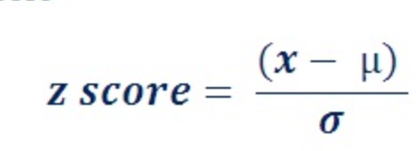
Z-Score
Variance and standard deviation are single numbers that describe the whole data set
The z-score is a statistic that describes how far away from the mean any single number in the data set is.
The z-score for a number in a data set tells us how many standard deviations away from the mean that number is.
Recall, the z-score for 1000 in our price data set is about 2.83, whereas for 41, it is -0.3.
No need to memorize! The libraries we will work with — namely SciPy — have them built-in.

Slide 21
Outliers

Slide 22
Outliers
Extreme values often do not describe the data…
It is okay to remove outliers if any of the following are true:
The data is due to bad measurements. (If your data includes reaction time measurements, and one of the values is 1ms, you should probably remove it — human reaction times are at least 100ms, so 1ms is clearly bad data.)
If the outliers create trends that wouldn't exist without them, you should drop them.

Slide 23
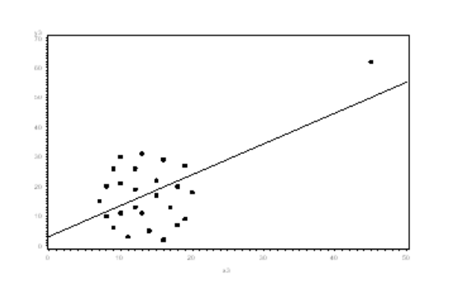
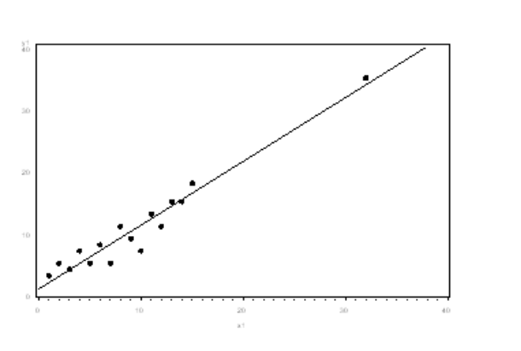
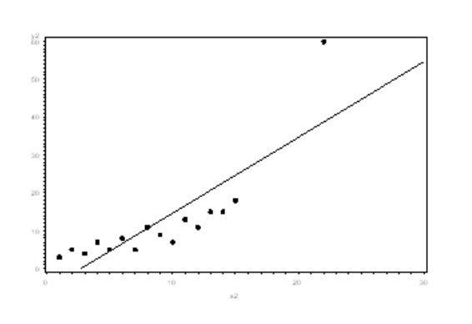
Outliers - To remove or not to remove?

Slide 24
Outliers- To remove or not to remove?
The outliers do not change your results. In this case, it is okay to drop them, but it is best to make a note of having done so.
If the outliers create trends that wouldn't exist without them, you should drop them
If your outlier does change your results, you should not drop it
http://www.theanalysisfactor.com/outliers-to-drop-or-not-to-drop/

Slide 25
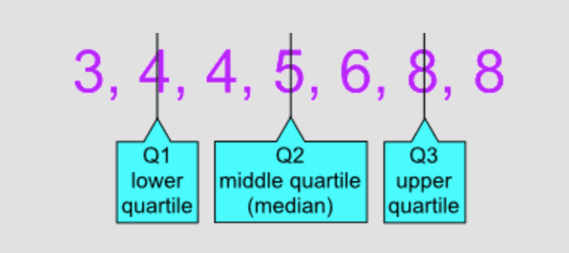
Outliers- Seem ‘fuzzy’?

Slide 26
Outliers- Example
Samples.py

Slide 27
Integrity of Data

Slide 28
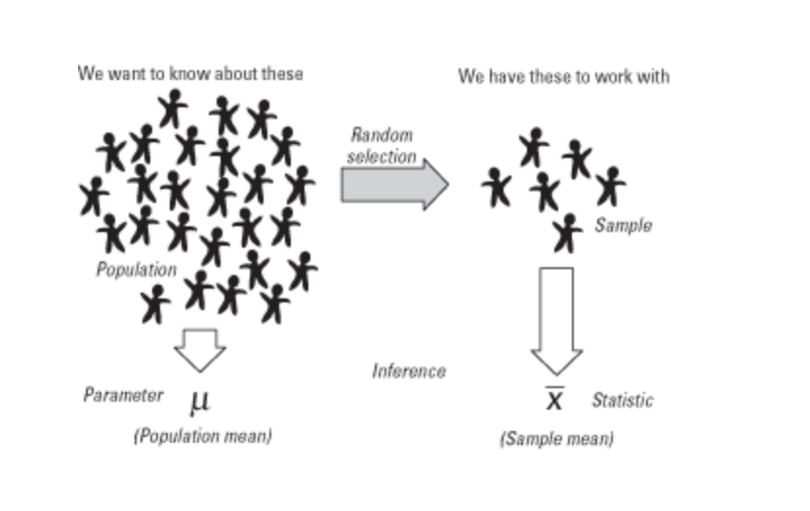
Do we trust our data? SEM and Error Bars
We will focus on the notions of standard error and how well measurements of a section of a population (e.g., voting habits of Americans in cities) represent that population as a whole (e.g., all Americans).

Slide 29
This process can lead to imperfect predictions….why?

Slide 30
This process can lead to imperfect predictions.why?
A small sample might not realistically represent a large population, and that even a large sample, if chosen poorly, might not describe the population at large.
For example, if we poll only college students and people who live in cities, we will almost certainly make bad predictions, because this sample does not represent the entire population.

Slide 31
Do we trust our data? SEM and Error Bars
Let's say we read election predictions from two different sources.
One source made predictions from a sample of 1,000 people;
The other made predictions from a sample of 10,000.
Which we would trust more, and why?

Slide 32
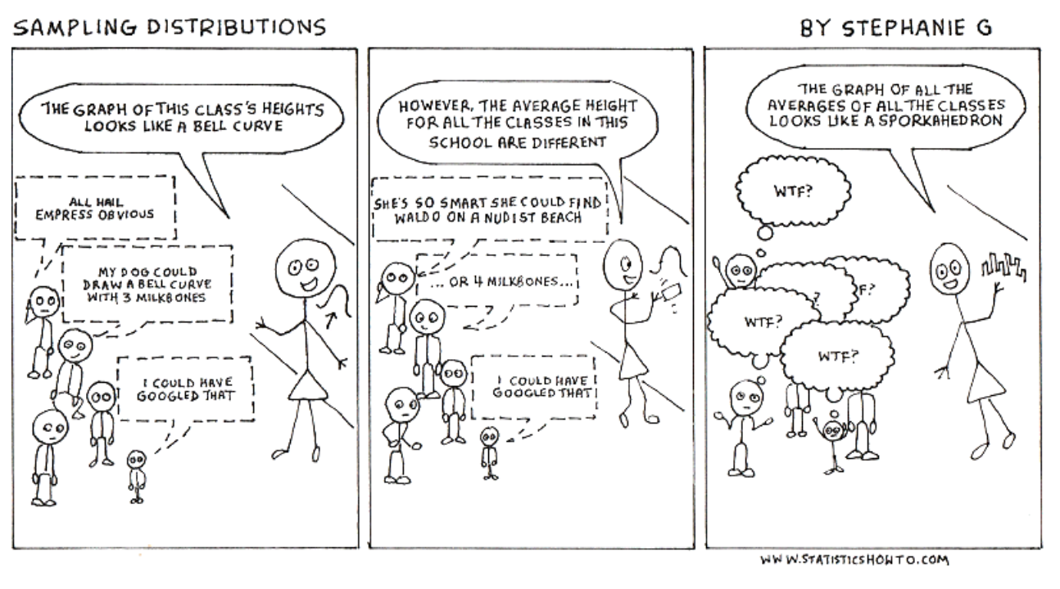
Do we trust our data? SEM and Error Bars
Since a sample is just a subset of the whole population, we can poll multiple samples to get more accurate estimates of how the population behaves.
http://www.statisticshowto.com/sampling-distribution/

Slide 33
Do we trust our data? SEM and Error Bars
If we take multiple samples, the collection of samples themselves is a data set.
If we have 100 samples, we create a list of the samples' standard deviations.
We can use these numbers to calculate something called standard error, which is an estimate how well the samples represent the population.
Each sample's standard error describes how far its mean is from the population's "true" mean.
The formula is unimportant — there is a function in SciPy that does this for us.

Slide 34
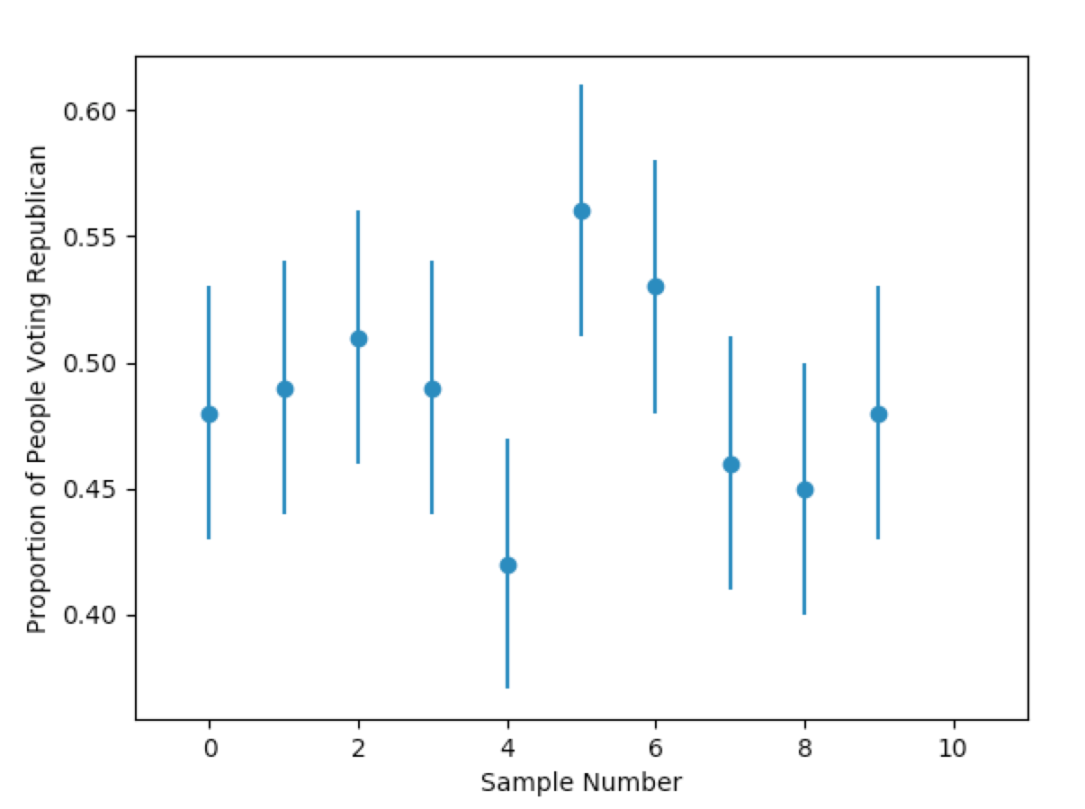
SEM and Error Bars - Example
Samples.py
Most of the error bars overlap
Summary: errorbars to provide a visual indicator as to how confident we were in the proximity of our sample means to the "true" population mean.

Slide 35
Student’s t-test

Slide 36
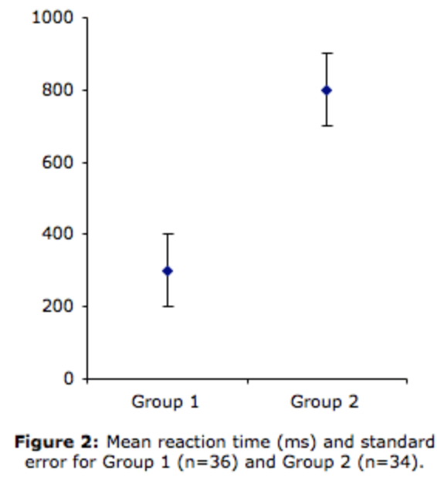
Student’s t-test
If we plotted the errorbars of our data and found that most of them did not overlap, it would raise questions about the data.
Suppose, for instance, that about half of the means had error bars that overlapped one another, and the other half had error bars that overlapped one another, but neither cluster's error bars overlapped the other's.
In this case, we might expect that the two clusters were not randomly selected from the same population

Slide 37
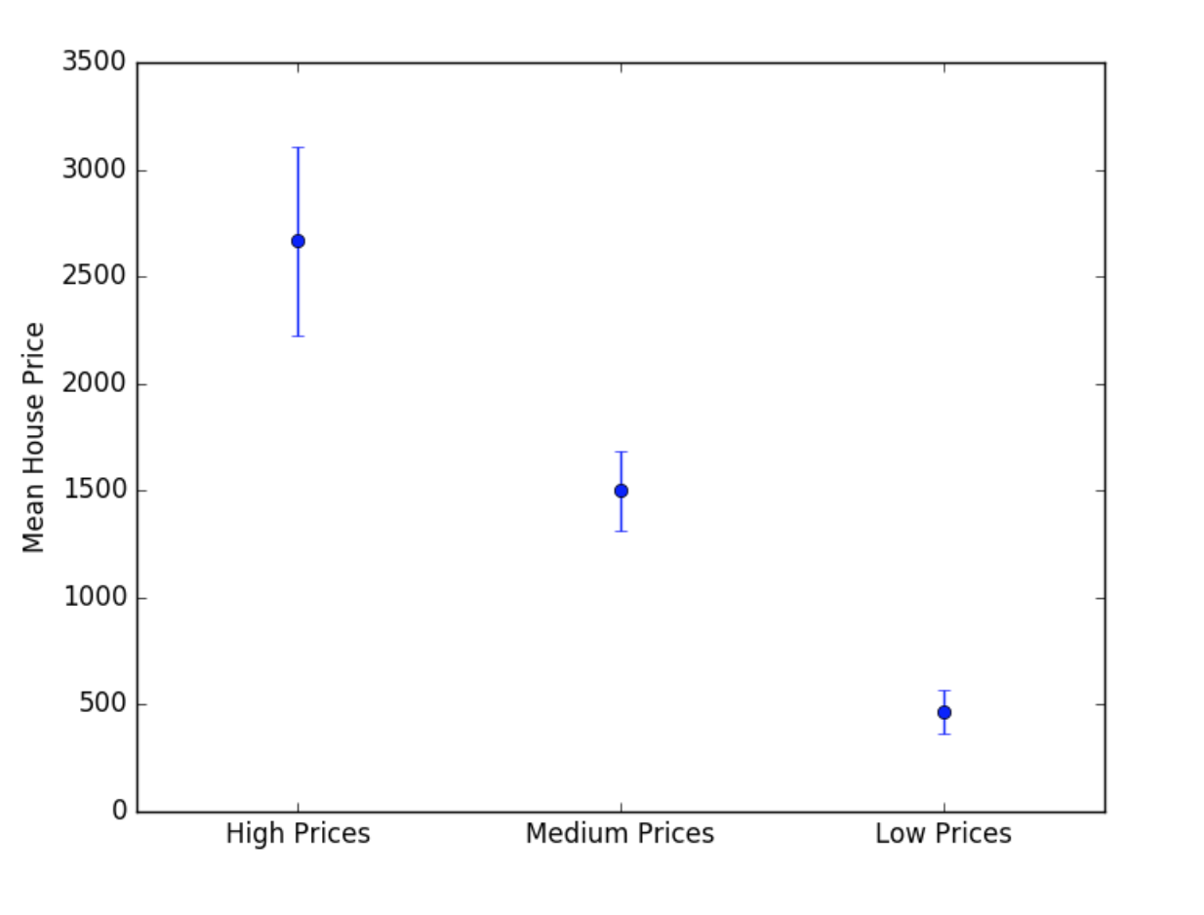
Student’s t-test
One way we might end up with an effect like this would be to generate one sample with prices from a rich neighborhood; another with prices from a poor neighborhood; and one with prices from a middle-class neighborhood.
In this case, we would end up with three wildly different means, with error bars that (probably) would not overlap.
Example: silly samples example file

Slide 38
Fits & Regression

Slide 39
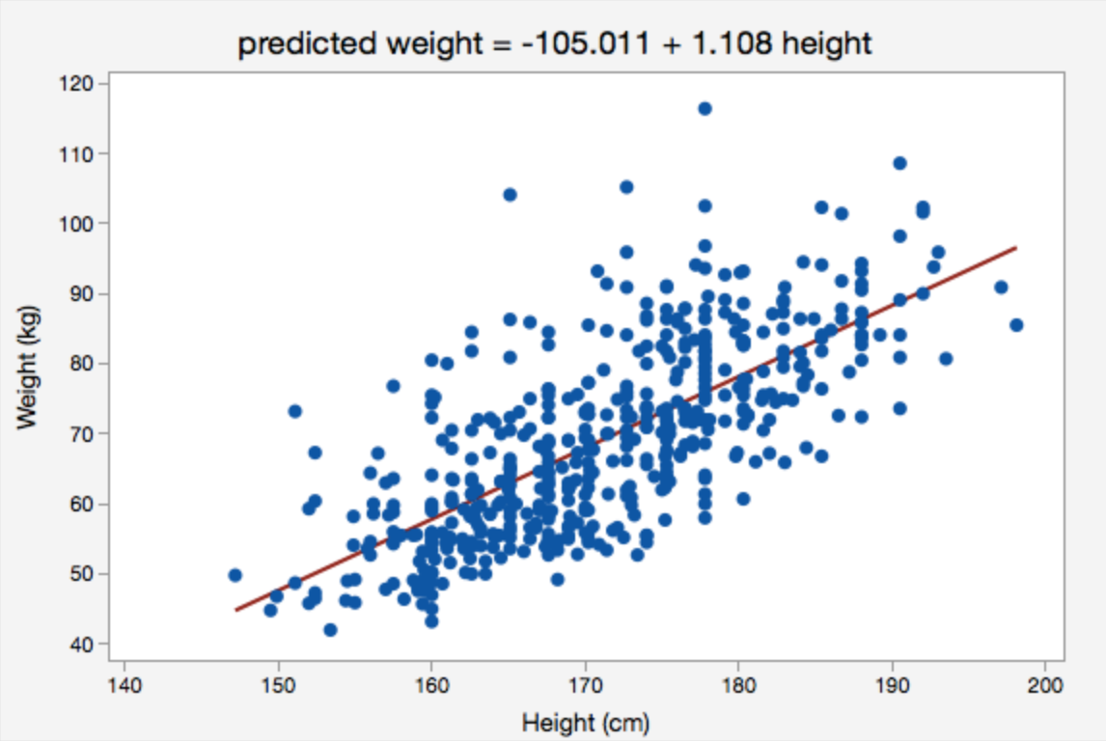
Regression
Regression analysis allows us to take a data set and "reverse engineer" an equation describing it.
Measures like the median, variance, and IQR describe data sets, but do not allow us to make predictions with it.
It is tools like regression that allow us to predict where data points we did not measure might end up if we had collected more data.
Example: regression.py

